Slide 1
Stupid Browser Tricks
Create Your Own Webpage in 5 minutes
by Chris Winikka

Slide 2
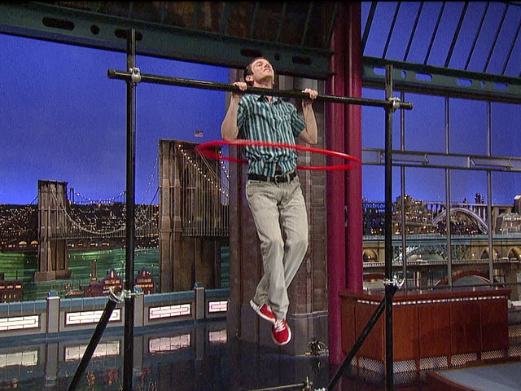

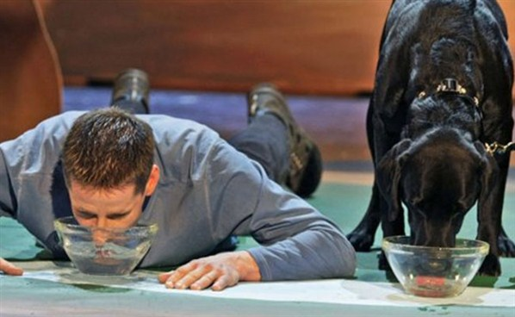
Remember Letterman’s Stupid Human Tricks?

Slide 3
Our Goal
Learn a little about the language browsers speak: HTML
Acquire some sweet keyboard shortcut tricks
Play a Mad Lib Game
Turn ourselves into Time’s 2010 Person of the Year

Slide 4
The Tools We’ll Need
Internet Connection
A browser
A (free) text editor program
Notepad (comes with Windows)
Notepad++ (my favorite)
TextEdit (comes with Mac)
TextWrangler (the one I like for Mac)
Your wits about you

Slide 5
The Steps We’ll take
Open a browser and go to poy.time.com: Time’s Person of the Year
Pick a Famous Person of the Year
Copy the HTML into your text editor
View source
Select all & copy
Paste the HTML into new document
Find and replace the Famous Person with your name
Save as MyBio.html
View your page in a browser
Go to town with copy and paste

